Slide 1

Project Work Photo upload system
Prachurja Kanti Barman Praggo
UG02-49-18-002
State University of Bangladesh

Slide 2


Introduction
Webpage
Login System
Registration System
Logout System
Photo upload

Slide 3

Options
Upload photos
View photos
People can see Photos (who are registered)

Slide 4

Language
PHP
HTML
CSS
MySQL

Slide 5

Environment
Editor
visual studio code, Sublime Text Editor
Server
Apache
MySQL-Server
XAMPP

Slide 6


Login Page
Outlook
Design
Slider

Slide 7


Signup Page
Outlook
Design
Slider

Slide 8

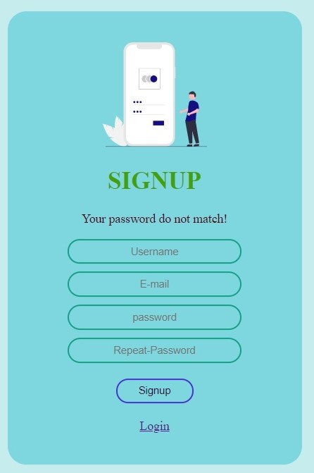
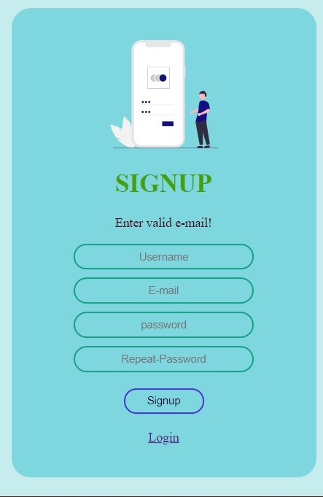
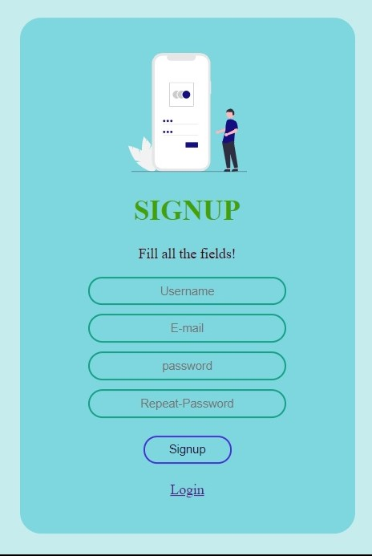
Signup Page
Error handling
With php
Hash
Password

Slide 9

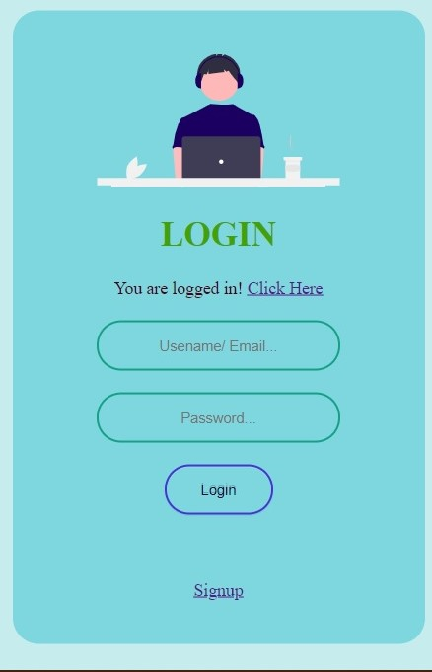
Login Page
Successfully Login
Go to Homepage

Slide 10

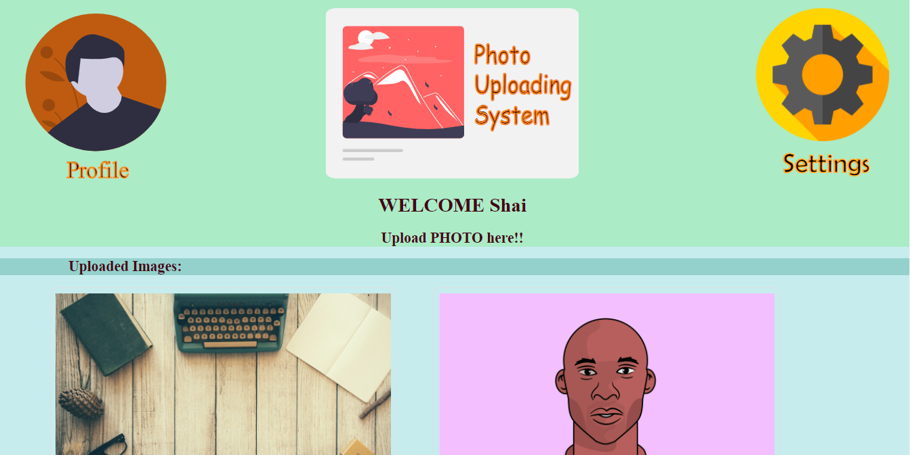
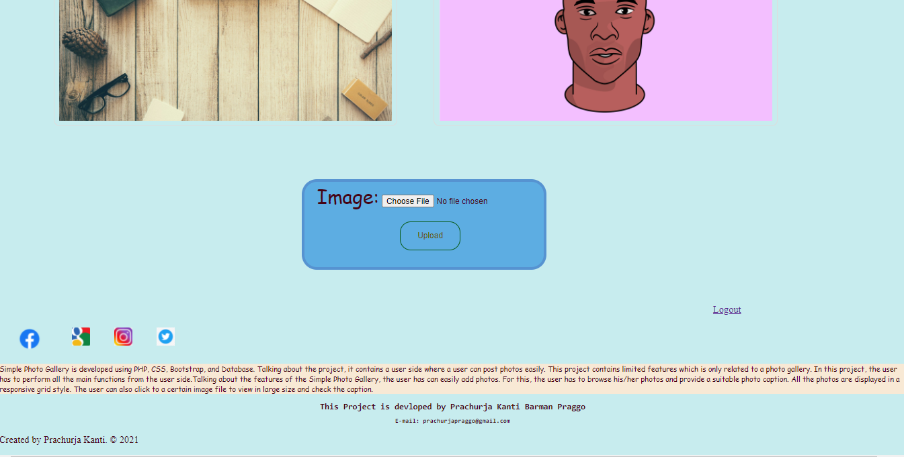
Home Page
Profile Logo
Website Logo
Setting Logo
Welcome
Show name
Uploaded images
Upload form

Slide 11


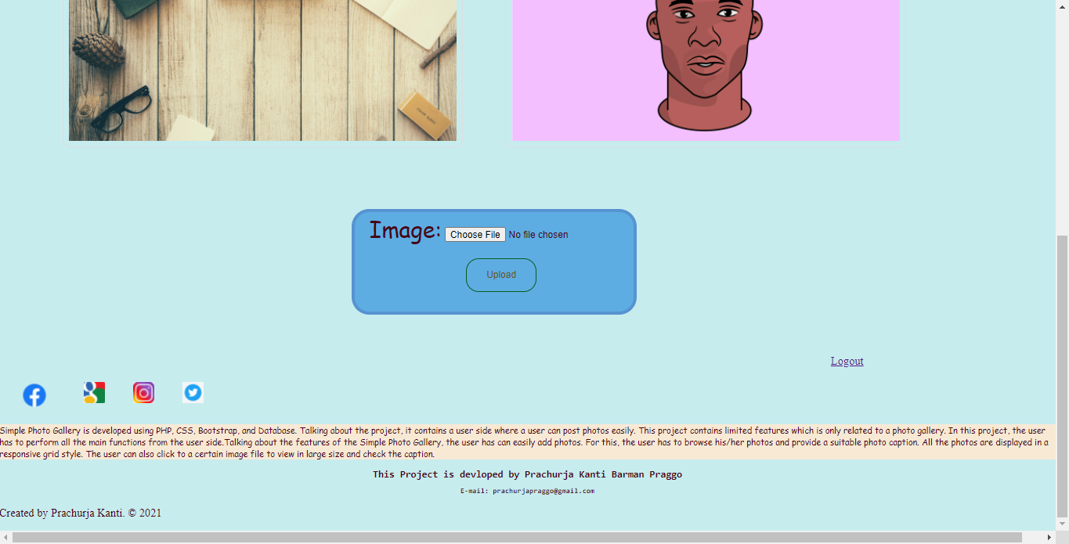
Logout
Back in Login Page
Photo Uploading
Photo view
Social Media
About the website

Slide 12


